Slide 1

Lecture Notes: Image Convolution − Spatial
This work is licensed under the Creative Commons Attribution-Noncommercial 2.5 License. To view a copy of this license, visit http://creativecommons.org/licenses/by-nc/2.5/ or send a letter to Creative Commons, 543 Howard Street, 5th Floor, San Francisco, California, 94105, USA.

Slide 2
Point Operators & Neighborhood Operators
are the two major categories of image transformation. A point process changes the value of a pixel as a function only of its current value. I.e.
Neither the distribution of values nor the metric structure of an image has any effect whatsoever on the result of the operation. Spatially dependent processing requires an operator whose output at a point is a function of the area surrounding it – a neighborhood.
That is, Φ operates on the M ×N square of pixels in I_{in} centered on (r,c) to produce a single output value for I_{out} at location (r,c).
¹if I_{in} is a color image then the mapping is from ○³ to ○³.

Slide 3
Spatial Filtering
Neighborhood operators and moving window transforms such as convolutions and morphological operators (cf. Lectures 17 & 18) are spatial filters. Here is a more specific statement of the def:
Let I and J be images such that J = Φ [I]. Then on an M ×N rectangular window (M &N both odd),
That is, the value of the transformed image, J, at pixel location (r,c) is a function of the values of the original image, I, in an M ×N = (2m +1) × (2n +1) rectangular neighborhood centered on pixel location (r,c).

Slide 4
Image Neighborhood & Shift Invariance
In image, I, a neighborhood (abbreviated nbhd) of pixel location (r,c) is a rectangular set of pixels that includes (r,c) and has a specific shape (as determined by its zero elements). It is the set of pixels
if M and N are odd. If M and/or N is even then
Neighborhood operator, Φ, is called “shift invariant” if both the geometry of the nbhd and the action of Φ is the same for every pixel location (r,c) ∈ I. All the nbhd ops in this course will be shift invariant.

Slide 5
Convolution
A convolution is a linear operator² Φ[I;h] denoted I∗h such that
for a real image (I:○×○→○). Or for a digital image (I:×→):
where I and J are R×C images and h is a 2m+1 × 2n+1 matrix that defines the size and shape of the convolution neighborhood.
²Image operator Φ is said to be linear if Φ[αI+βJ] = αΦ[I]+βΦ[J], where α,β∈○, I,J are images.

Slide 6
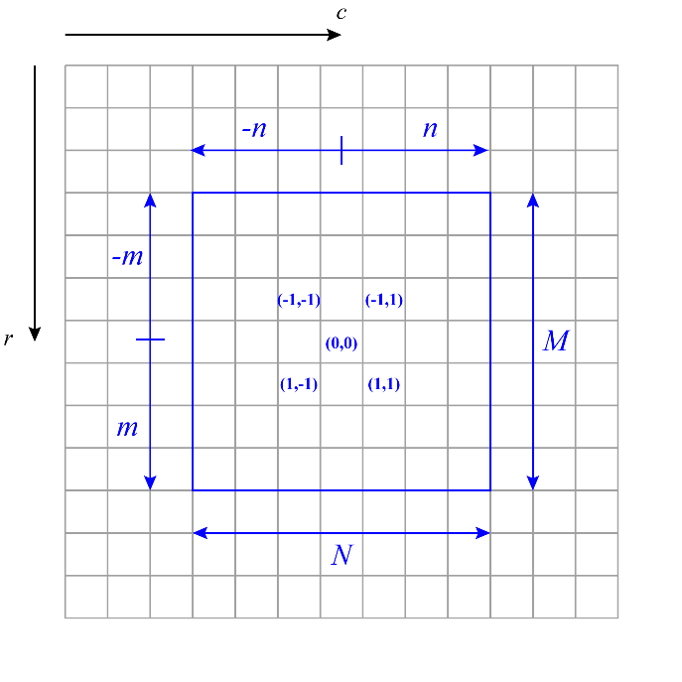
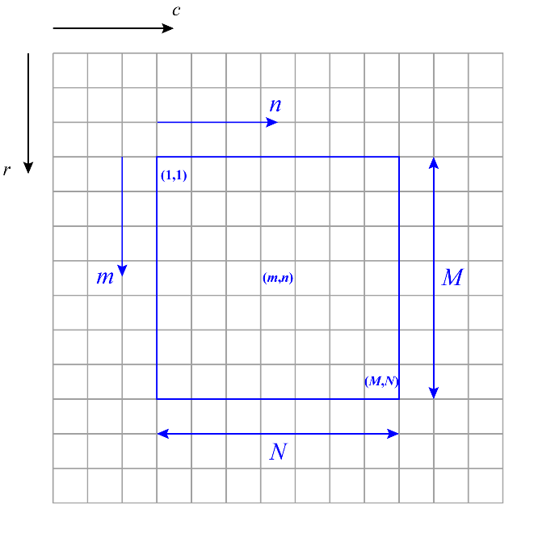
Convolution
A convolution’s nbhd is defined by its matrix, h.
Shift invariant neighborhood operators are sometimes called “moving window transforms” (MWT). Convolutions are linear MWTs and are the mathematical dual of multiplication in the frequency domain. Algebraically convolution is defined on a nbhd like the one on the left. Computationally convolution is performed on a nbhd like the one on the right. (Larger diagram on next slide.)

Slide 7
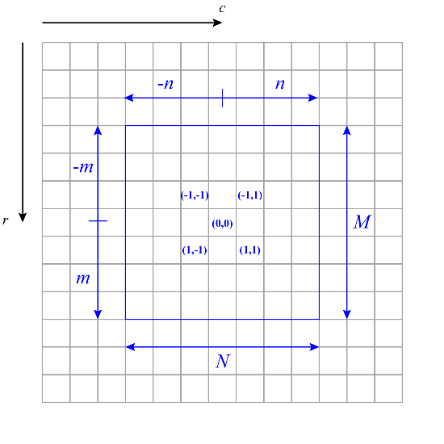
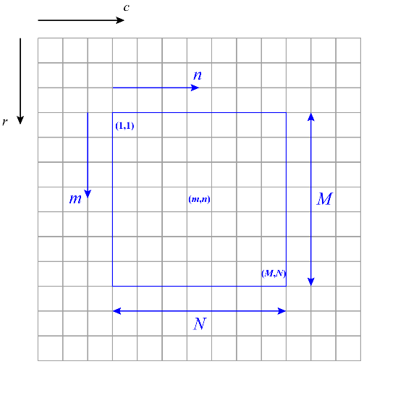
Convolution Neighborhood
A convolution’s nbhd is defined by its matrix, h.
(r,c)
(r,c)
I
I
used in math definition
used in computation

Slide 8
Boundary Effects in Convolution
If a convolution’s matrix, h, is M ×N and has its origin at
what happens when
That is when r or c is close to one of the image boundaries?
The convolution is indeterminate there; its value depends on the algorithm used to compute it. For example the image can be zero-padded (slides 45-48). Or the image’s right side can be joined to its left, its top joined to its bottom and the convolution performed on the resulting torus (slides 51-59).

Slide 9
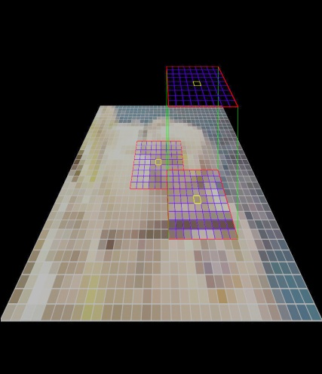
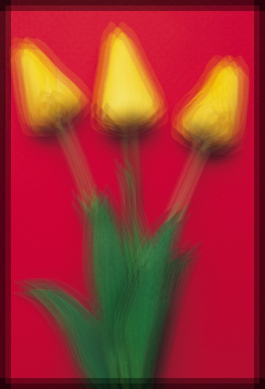
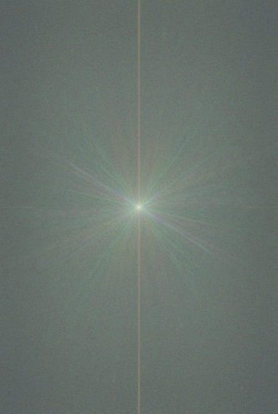
Three ways to compute a convolution
Moving window transform.
Shift multiply add.
Fourier transform.
1.
2.
3.

Slide 10
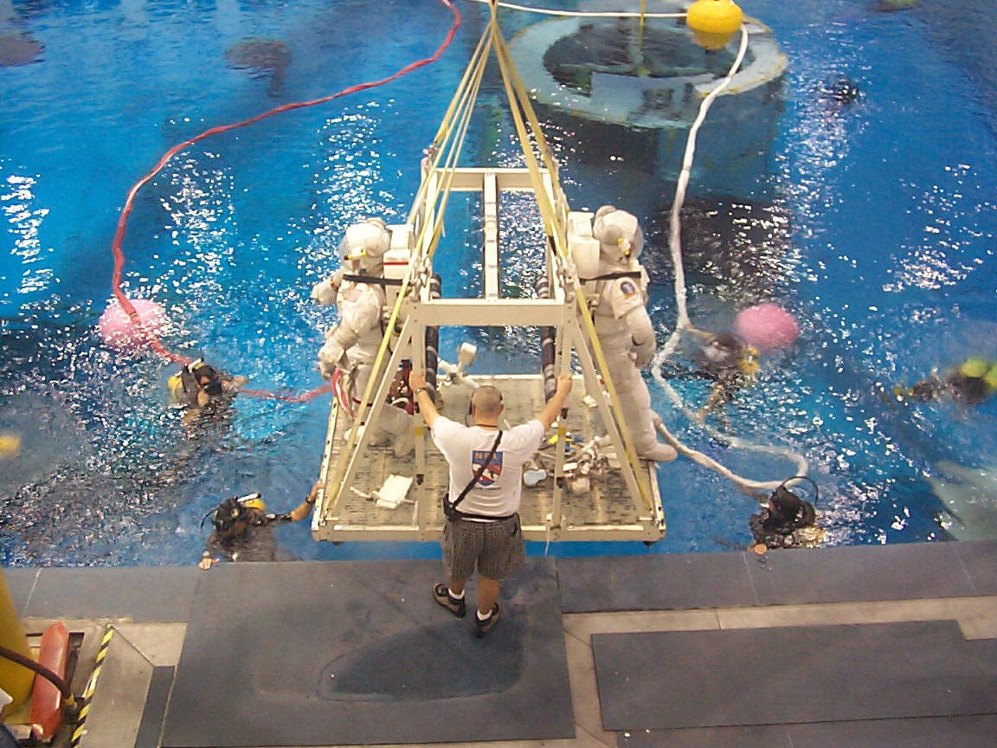
Moving-Window Transformations
Neutral Buoyancy Facility at NASA Johnson Space Center
We’ll take a section of this image to demonstrate the MWT.
photo: R.A.Peters II, 1999

Slide 11
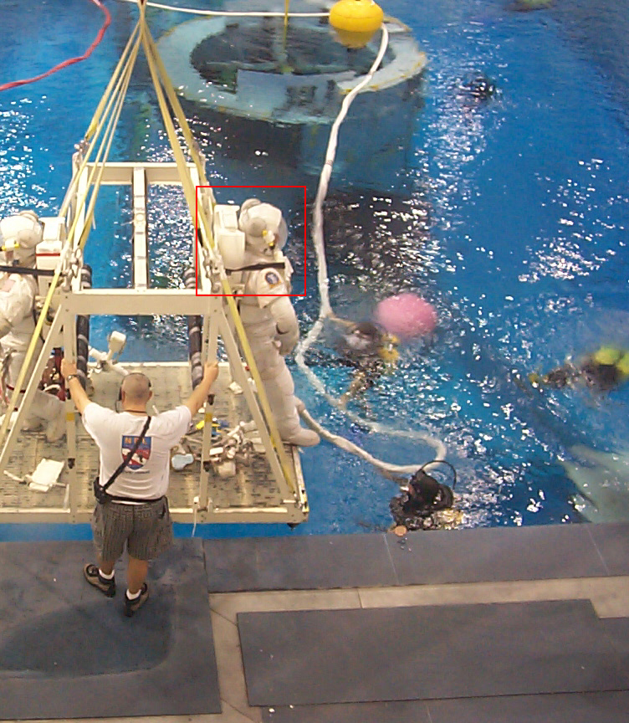
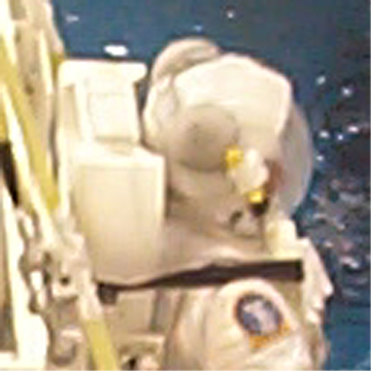
Moving-Window Transformations
Operate on this region.

Slide 12
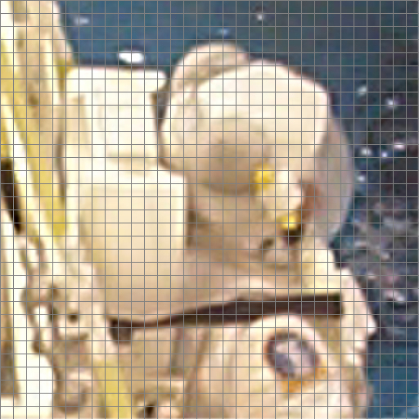
Moving-Window Transformations
Pixelize the section to better see the effects.
Apply a pixel grid.

Slide 13
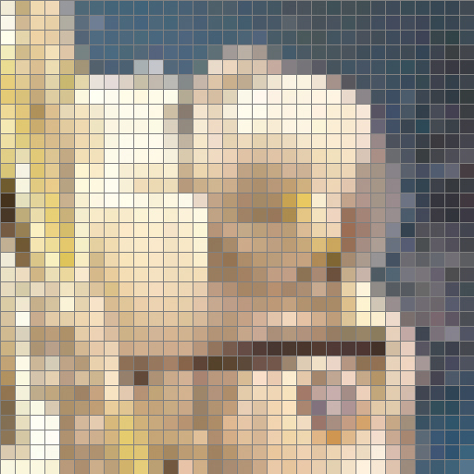
Moving-Window Transformations
Pixelize the section to better see the effects.
Sample (average in the squares).

Slide 14
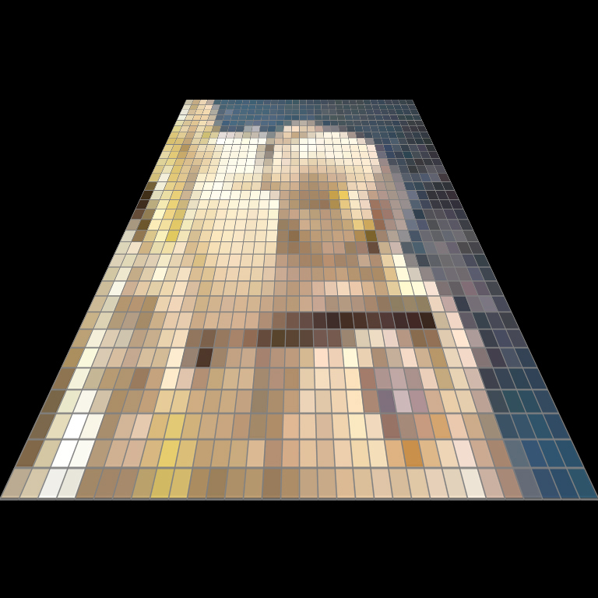
Moving-Window Transformations
Let’s put some perspective on this.

Slide 15
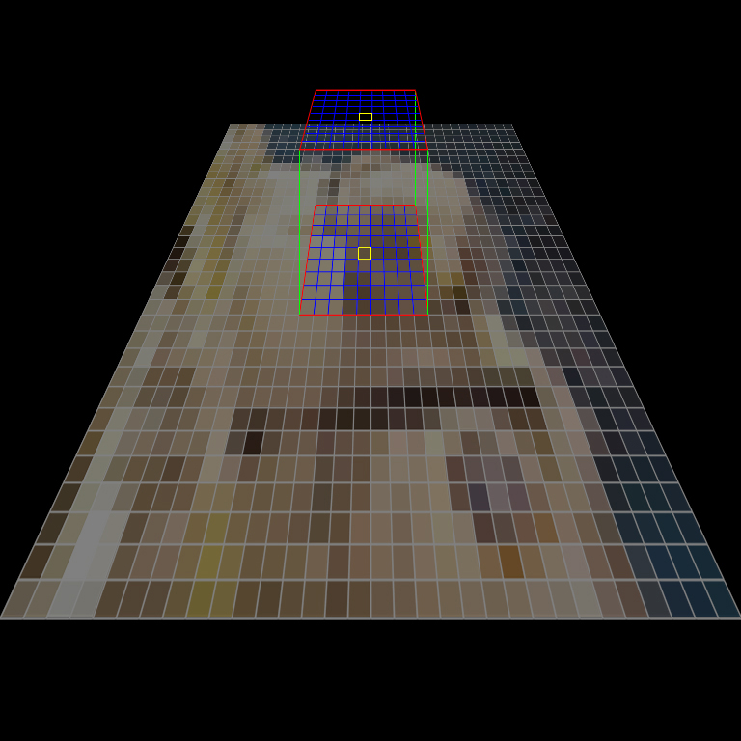
Moving-Window Transformations
A neighborhood defined by a weight matrix

Slide 16
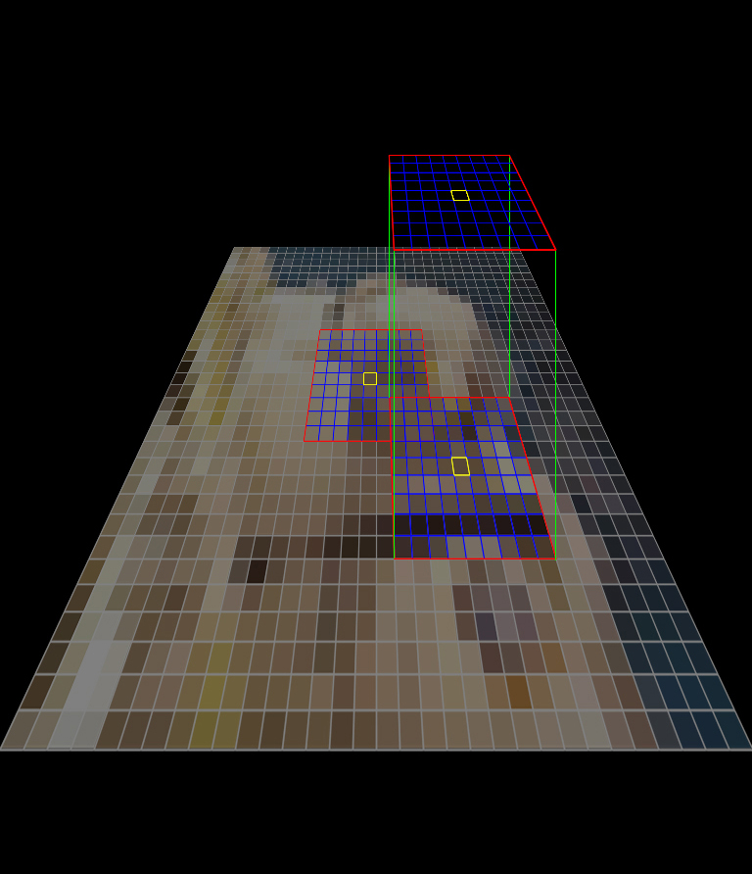
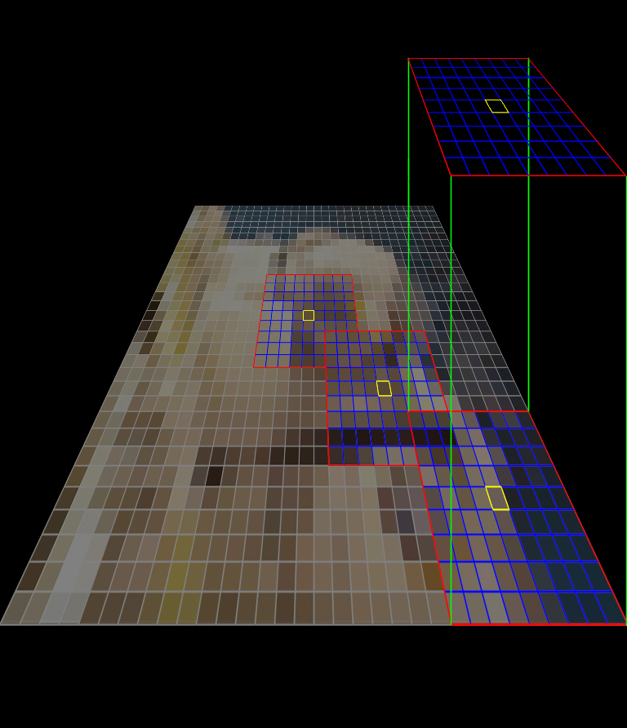
Moving-Window Transformations
Neighborhoods at other pixel locations

Slide 17
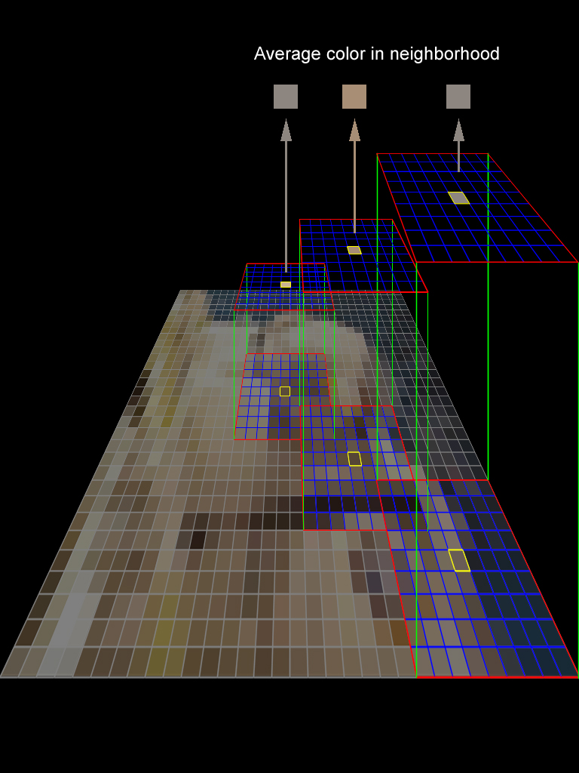
Linear Moving-Window Transformations ( i.e. a Convolution)
The output of the transform at each pixel is the (weighted) average of the pixels in the neighborhood.

Slide 18

Moving-Window Transformations
Result of a 9 x 9 uniform averaging

Slide 19


Moving Window Transform: Example
original
3x3 average

Slide 20
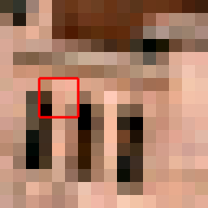
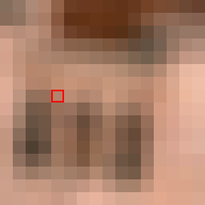
Moving Window Transform: Example
original
3x3 average

Slide 21
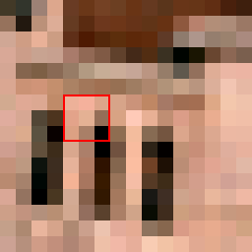
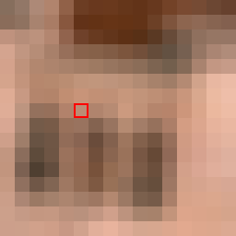
Moving Window Transform: Example
original
3x3 average

Slide 22
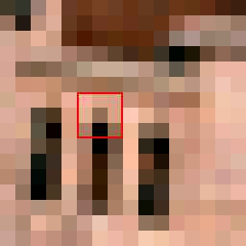

Moving Window Transform: Example
original
3x3 average

Slide 23
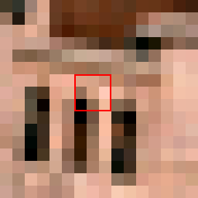

Moving Window Transform: Example
original
3x3 average

Slide 24
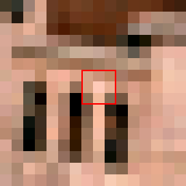

Moving Window Transform: Example
original
3x3 average

Slide 25
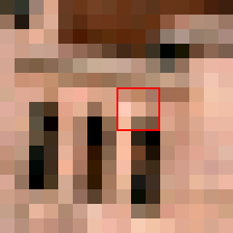
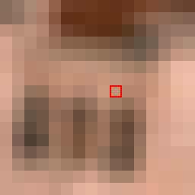
Moving Window Transform: Example
original
3x3 average

Slide 26
Convolution Matrix (Weight Matrix)
The object, h(ρ,χ), in the equation is a weighting function, or in the discrete case, a rectangular matrix of numbers.
The matrix is the moving window. It is called variously the weight matrix; convolution matrix, kernel, mask, or neighborhood; or a filter, filter kernel, or filter matrix. All the names mean the same thing.
Pixel (r,c) in the output image is the weighted sum of pixels from the original image in the neighborhood of (r,c) traced by the matrix.
Each pixel in the neighborhood of (r,c) is multiplied by the corresponding matrix value — after the matrix is rotated by 180º. (See slide 30).
The sum of those products is the value of pixel (r,c) in the output image.

Slide 27
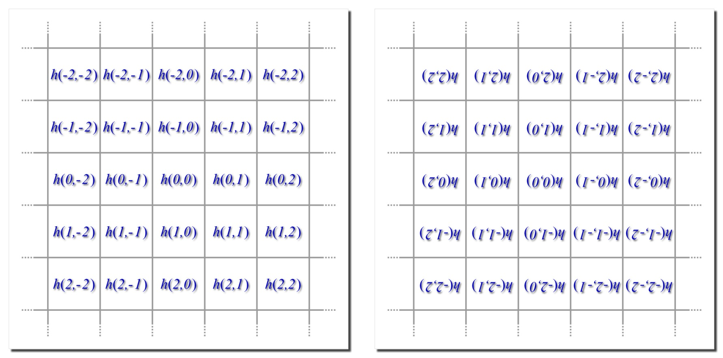
Convolution Matrices: Moving Window
When performed per the definition on p. 5, the convolution’s matrix must be rotated by 180° before the raster scan.
matrix origin
rotate 180°…
translate to pixel loc (r,c)
… around pixel loc (r,c)

Slide 28
Convolution Matrices: Moving Window
When performed per the definition on p. 16, the convolution’s matrix must be rotated by 180° before the raster scan.
multiplies pixel I(r-1,c)
multiplies pixel I(r-1,c-2)
multiplies pixel I(r,c-1)
multiplies pixel I(r+1,c+1)

Slide 29
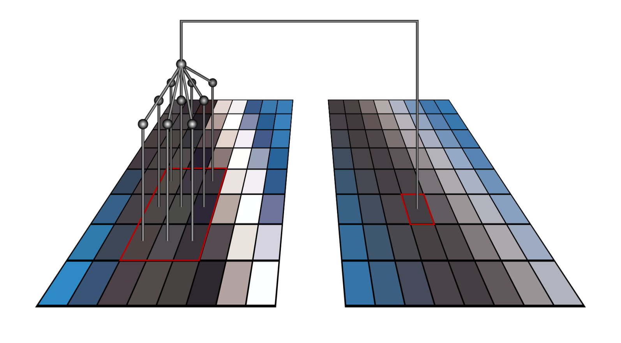
Convolution by Moving Window
i
g
f
c

Slide 30
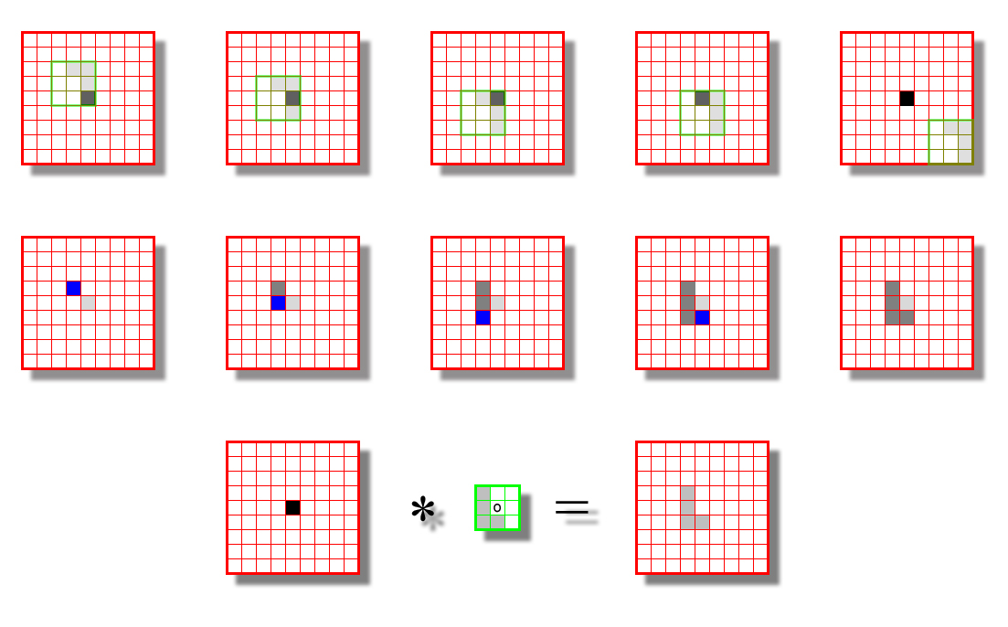
Convolution by Rotating and Shifting the Weight Matrix
The convolution of an impulse with a matrix places a copy of the matrix at the location of the impulse. That’s why we rotate the matrix by 180°.
At the locations not shown, the results were zeros.
Shifted weight matrix
Result of sum of products
Location of impulse
Accumulated nonzero results
The original image has a black impulse at the center and zeros (white) elsewhere.
The weight matrix has a gray ‘L’ at its left and zeros (white) elsewhere.
The resulting image has a copy of the weight matrix pegged to the impulse location.
14

Slide 31
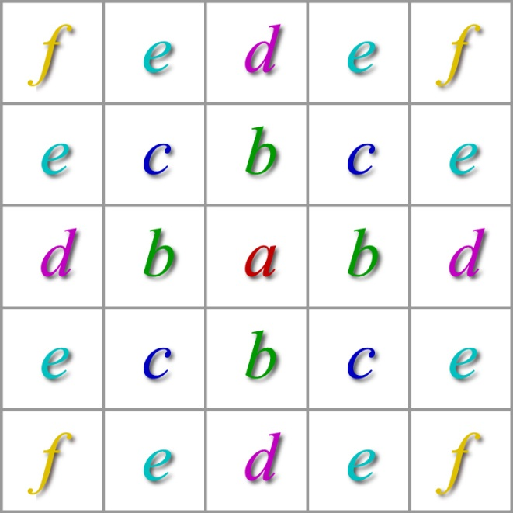
Symmetric Weight Matrix
A symmetric weight matrix is unchanged by rotation through 180°. Many commonly used filters have symmetric matrices. Many do not.

Slide 32
Convolution by an Impulse
An impulse is a digital image, that has a single pixel with value 1; all others have value zero. An impulse at location (ρ, χ) is represented by:
If an image is convolved with an impulse of weight w at location (ρ, χ), then the image is multiplied by w and shifted in location down by ρ pixels and to the right by χ pixels.

Slide 33


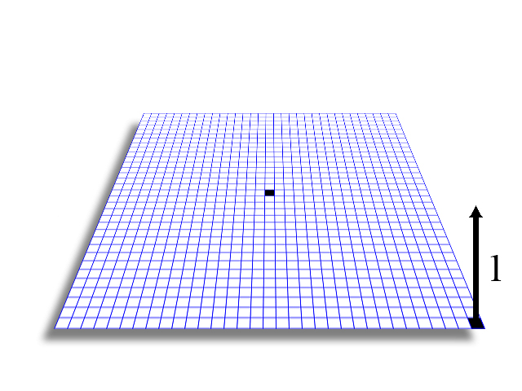
Convolution by an Impulse
Shifted down and to the right by 16 pixels.

Slide 34

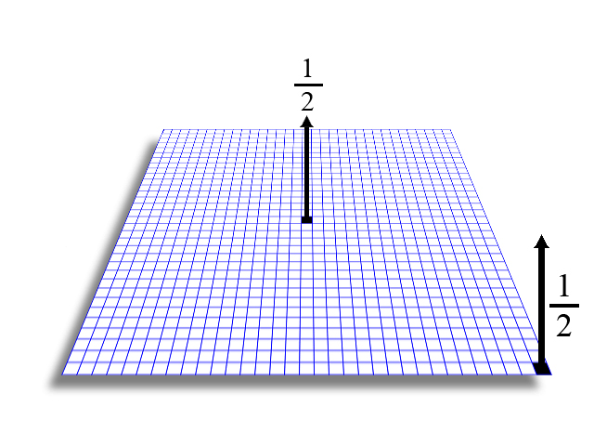
Convolution by Two Impulses
Two copies, one moved, one not moved, averaged.

Slide 35
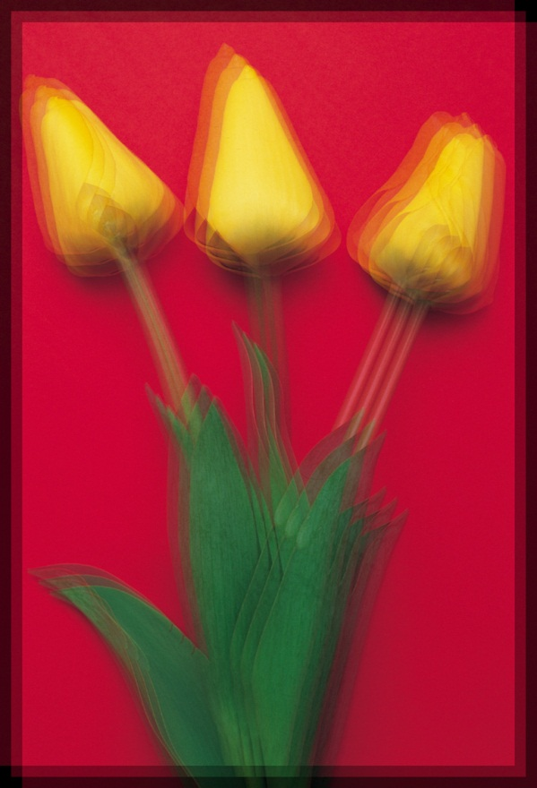
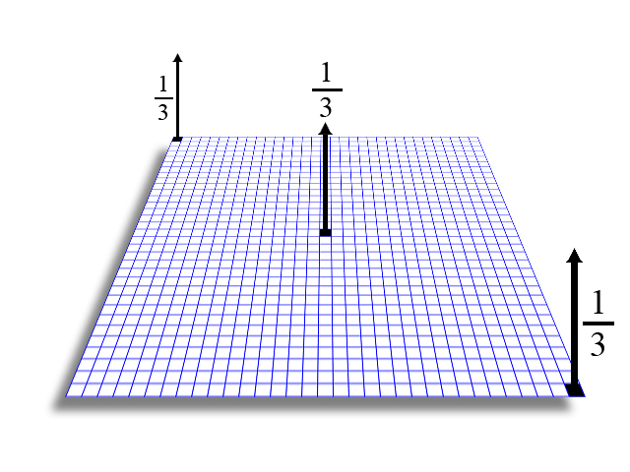
Convolution by Three Impulses
Three copies, two moved, one not moved, averaged.
Weights = 1/3

Slide 36

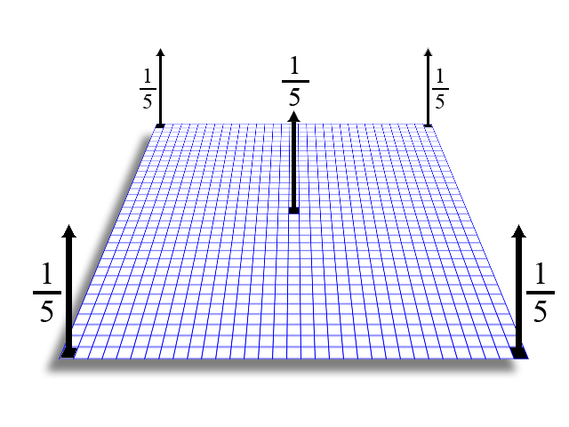
Convolution by Five Impulses
Five copies, four moved, one not moved, averaged.

Slide 37

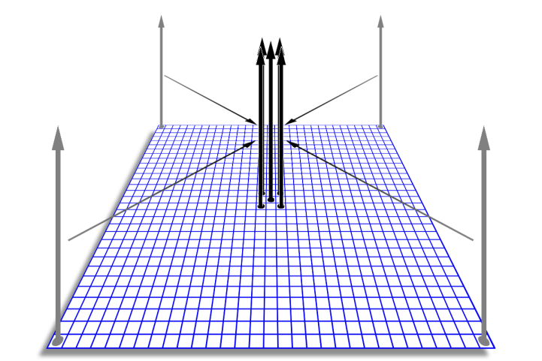
Convolution by Five Impulses
Moved adjacent to each other, the convolution becomes a blurring filter.

Slide 38
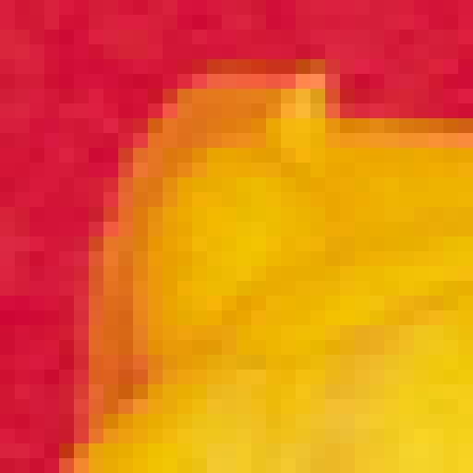
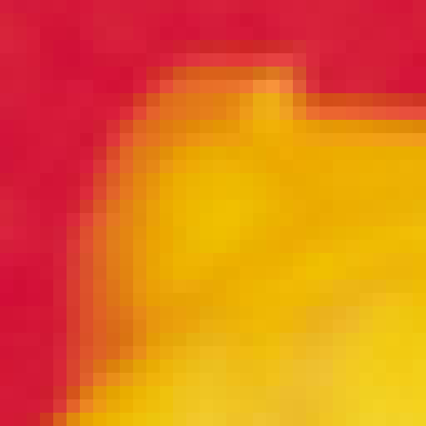
Convolution by Five Impulses
The impulses become values in a 3x3 neighborhood.

Slide 39
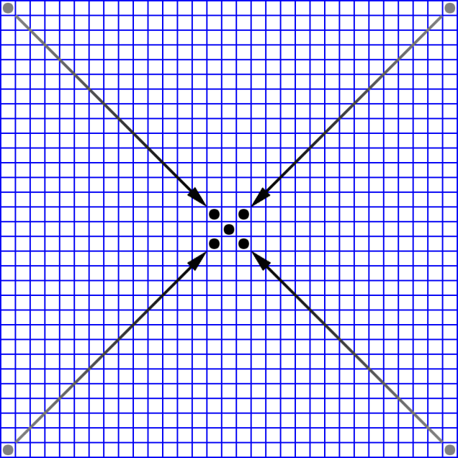
Convolution by Five Impulses
This convolution matrix has five elements at 1/5 and four at 0.

Slide 40
Shift-Multiply-Add Convolution
The image is copied 1 time for each element in the convolution matrix.
Each copy is shifted relative to the original by the displacement of its associated matrix element.
Each copy is multiplied by the value of its associated matrix element.
The set of shifted and multiplied images is summed pixel wise.

Slide 41
Shift-Multiply-Add Convolution
Assume images I and J are R×C×B and that h is M×N×1
Create a zero image, A, of size R+M -1 × C+N -1 × B
For m∈{1, …, M} and n∈{1, …, N} do:
i = [m m+1 ☹ m+R-1], j = [n n+1 ☹ n+C-1]
A(i,j,:) = A(i,j,:) + h(m,n)·I
End for
r =[ ⎣M/2⎦+1 ⎣M/2⎦+2 ☹ ⎣M/2⎦+R]
c =[ ⎣N/2⎦+1 ⎣N/2⎦+2 ☹ ⎣N/2⎦+C]
J = A(r,c,:)

Slide 42
Convolution by Copying and Shifting the Image
Image I is RxC
C + N - 1
A
To use the image shift-multiply-accumulate algorithm, create an accumulator image, A, that is R+M-1 rows by C+N-1 columns
I
R
R + M - 1
N
h
C
M

Slide 43
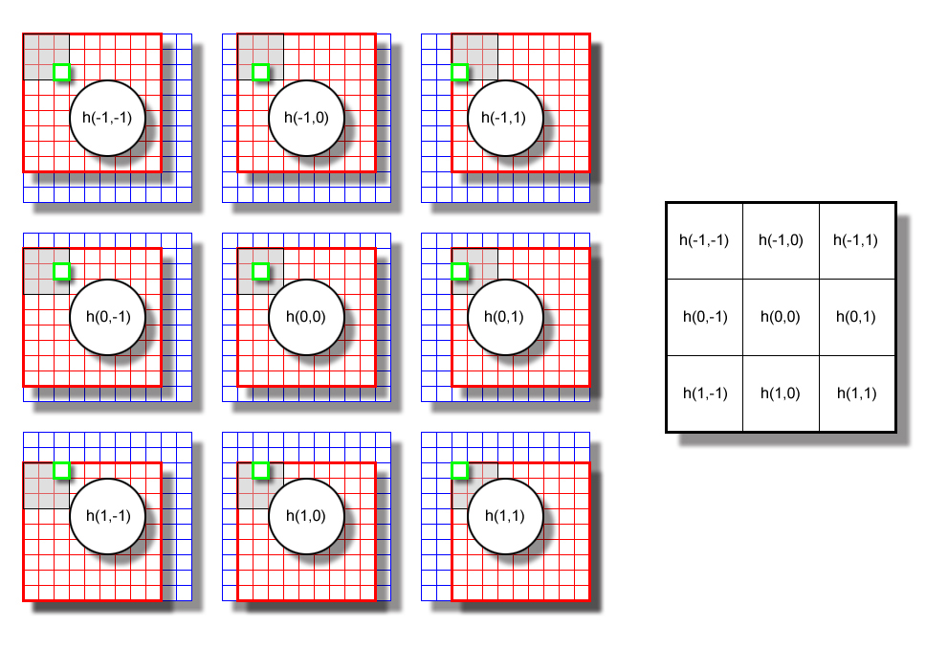
Convolution via Copy, Multiply, and Shift of the Image
For each element h(m,n) in an M×N weight matrix, h, R×C image I is multiplied by h(m,n) then added to a zero-padded accumulator image, A, in the R×C rectangle with upper right corner (m,n) and lower right corner (m+R-1,n+C-1).
After all M×N matrix elements have been looped over, the R×C result is cropped out of A starting at the origin of h, typically (⎣M/2⎦+1, ⎣N/2⎦+1)
original image, I
accumulator image, A
effective neighborhood
weight matrix
aligned pixels (r,c) are summed
weight for image

Slide 44
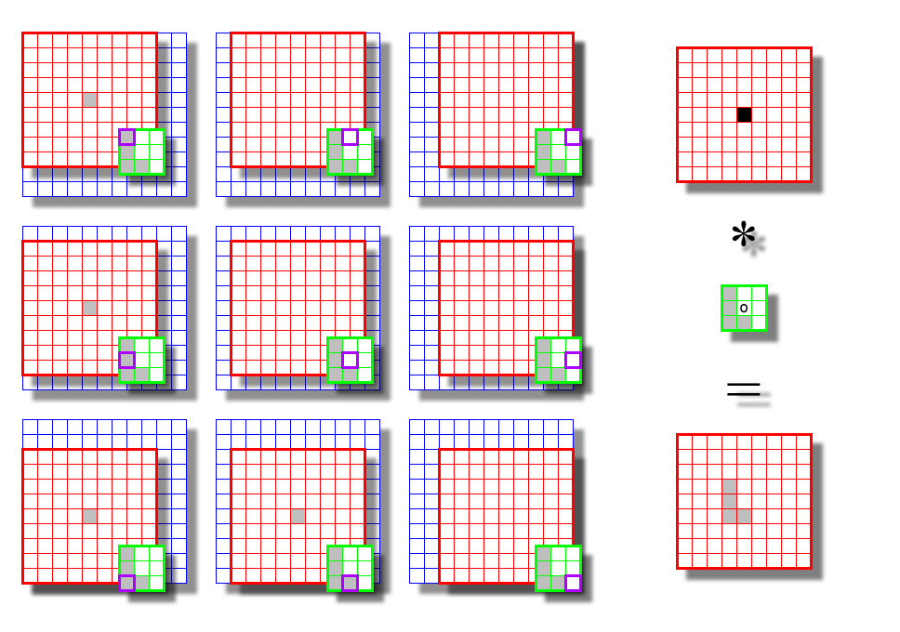
Convolution via Copy, Multiply, and Shift of the Image
The original image has a black impulse at the center and zeros (white) elsewhere.
The weight matrix has a gray ‘L’ at its left and zeros (white) elsewhere.
The resulting image has a copy of the weight matrix pegged to the impulse location.
original image, I
effective neighborhood
accumulator image, A
In the result, the origin of the weight matrix coincides with the original location of the impulse.

Slide 45
Convolution by Copying, Multiplying, and Shifting the Image
Each copy of the (entire) image is multiplied by the value of the weight matrix in purple square (here, white = 0) before being accumulated (pixelwise) in the padded image
The position of the purple square relative the center of the weight matrix indicates the shift of the original image relative to the middle of the padded image.
In this image, only the pixel in the center is nonzero so only it shows a result when the image is multiplied by a nonzero value

Slide 46
Convolution by Copying, Multiplying, and Shifting the Image
Each copy of the (entire) image is multiplied by the value of the weight matrix in purple square (here, white = 0) before being accumulated (pixelwise) in the padded image
The position of the purple square relative the center of the weight matrix indicates the shift of the original image relative to the middle of the padded image.
In this image, only the pixel in the center is nonzero so only it shows a result when the image is multiplied by a nonzero value

Slide 47
Zero Padding an Image for Convolution: Variable names.
weight matrix, h
cpad
C
B
N
rpad
d
M
R
Image, I
cpad = floor( N / 2 )
rpad = floor( M / 2 )
hcorig = cpad + 1
hrorig = rpad + 1

Slide 48
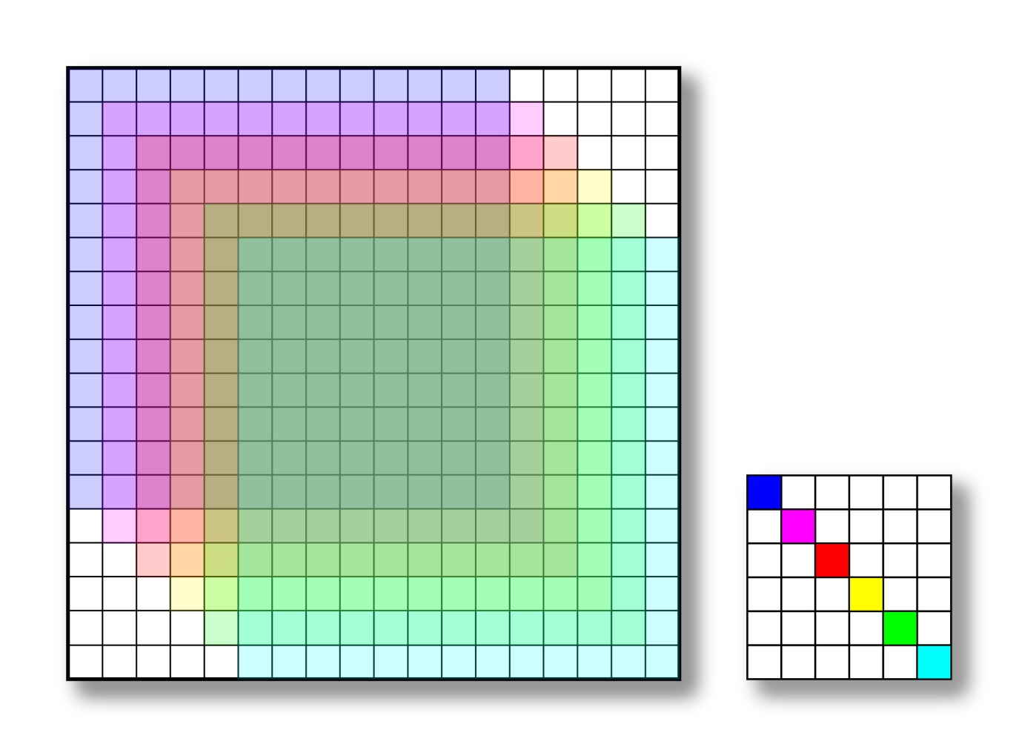
Convolution by Copying, Multiplying, and Shifting the Image
13x13 image
convolved by
6x6 matrix.
accumulator
output image
Image is constant; matrix has only 6 nonzero values all on the diagonal.
conv. matrix
Image is shifted to matrix location, multiplied by value, and accumulated.

Slide 49
Convolution by Copying and Shifting the Image
hcorig
hcorig+C-1
hrorig
output image, J
R
When done, copy the output image from the accumulator starting at (hrorig, hcorig) and ending at (hrorig+R-1, hcorig+C-1)
hrorig+R-1
C

Slide 50
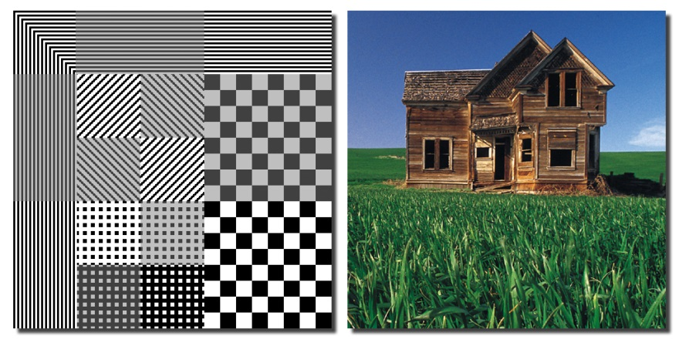
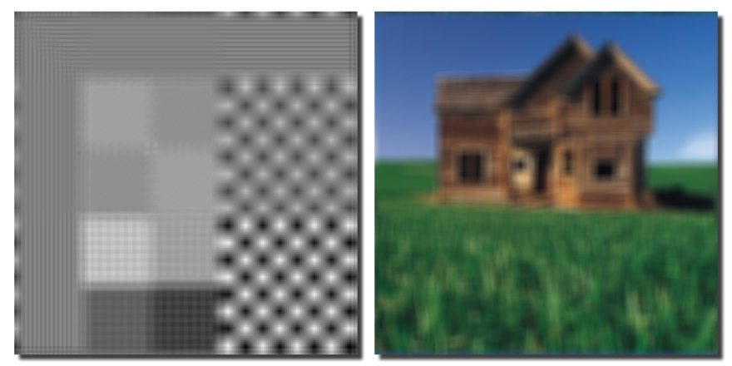
The Box Filter
A square convolution matrix with uniform weights that sum to 1 is called a box filter. Convolution matrices do not have to be uniformly weighted. Nevertheless, if the weights are all positive and sum to 1, the result of convolution is blurring. If the weights are both positive and negative and sum to 0, then the filter is an “edge detector”.

Slide 51
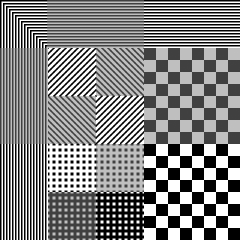
Convolution on a Torus
The 2D Discrete Fourier transform is defined on a torus. And it can be used to perform a convolution.
9x9 box filter
test pattern image

Slide 52
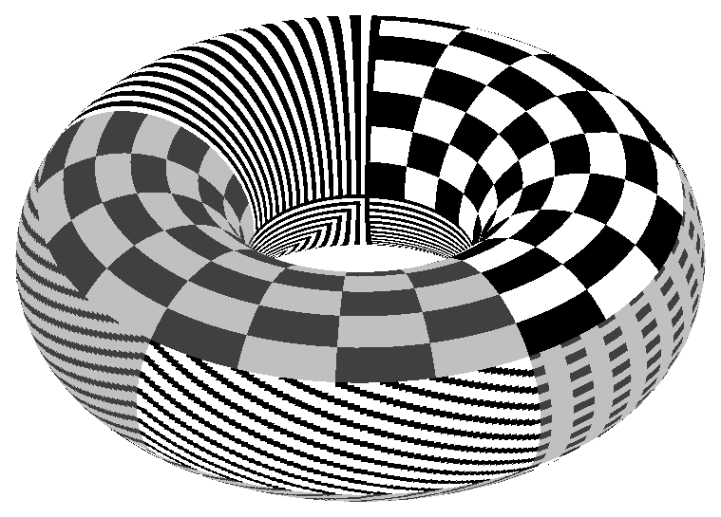
Convolution on a Torus
The FT computes the convolution on a torus so opposite sides of the image affect each other.
test pattern image on a torus

Slide 53
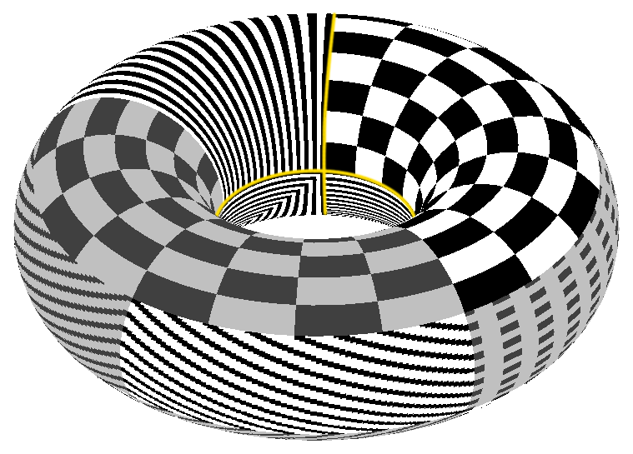
Convolution on a Torus
The effects of convolution on a torus can be seen in the examples that follow.
boundaries of original image

Slide 54
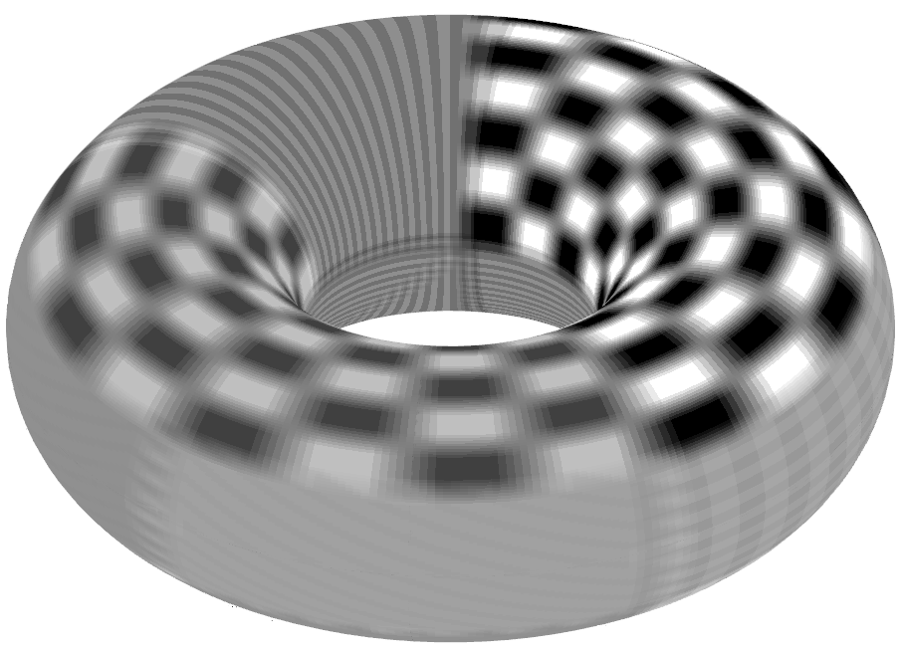
Convolution on a Torus
Here, a 9x9 box filter convolution was applied to the torus.
patterns smeared across the boundaries

Slide 55

Convolution on a Torus: Original Images

Slide 56
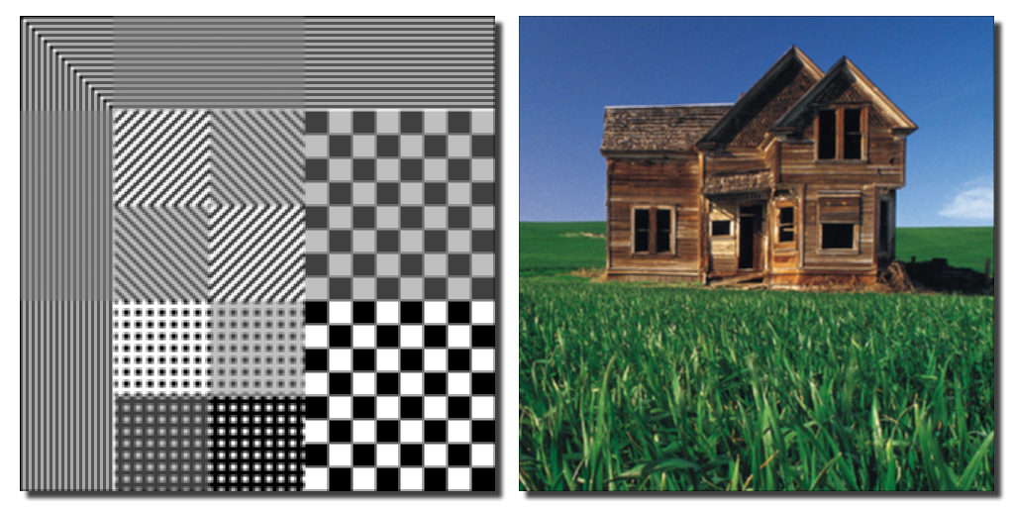
Convolution on a Torus: 3×3 Box Filter

Slide 57
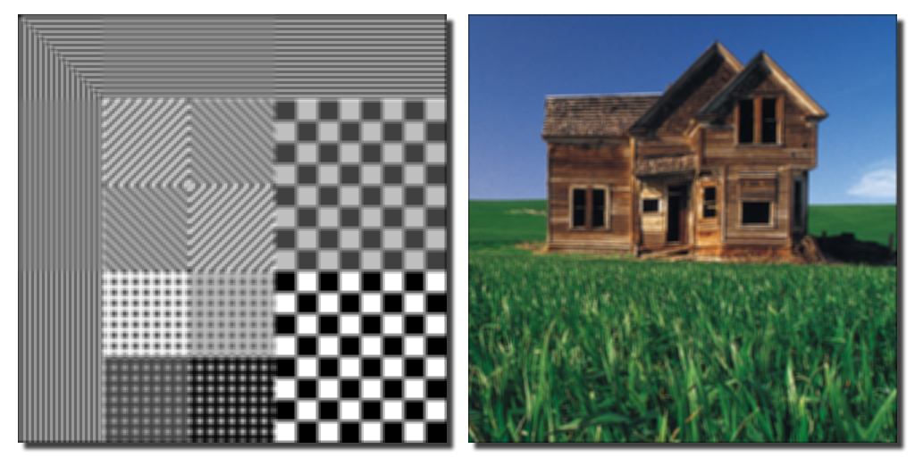
Convolution on a Torus: 5×5 Box Filter

Slide 58

Convolution on a Torus: 9×9 Box Filter

Slide 59

Convolution on a Torus: 17×17 Box Filter

